Slide 1


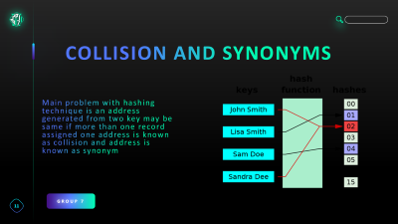

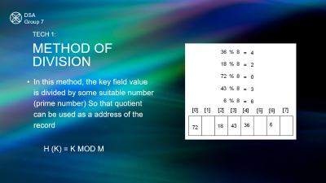


GROUP 7
FILE
ORGANI-
SATION

Slide 2


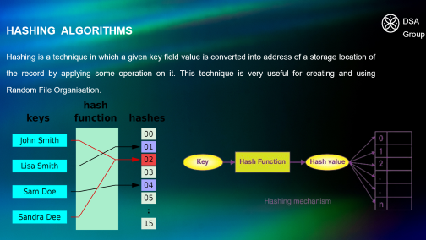


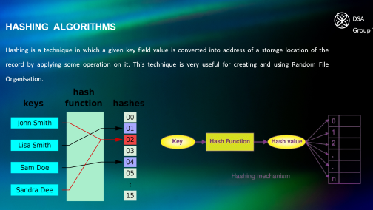
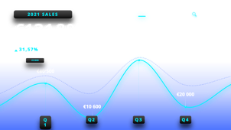
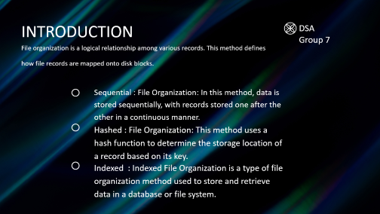
GROUP 7
HASHING
ALGORITHEM
DIRECT ACCESS FILE ORGANISATION | RANDOM FILE ORGANISATION
VANSH
CHAWLA

Slide 3


INTERACTIVE
NEON
CHARTS
Provide some key insights on your company sales. Keep it short and sweet.
MORPH
ZOOM

Slide 4



Slide 5


Slide 6


Slide 7


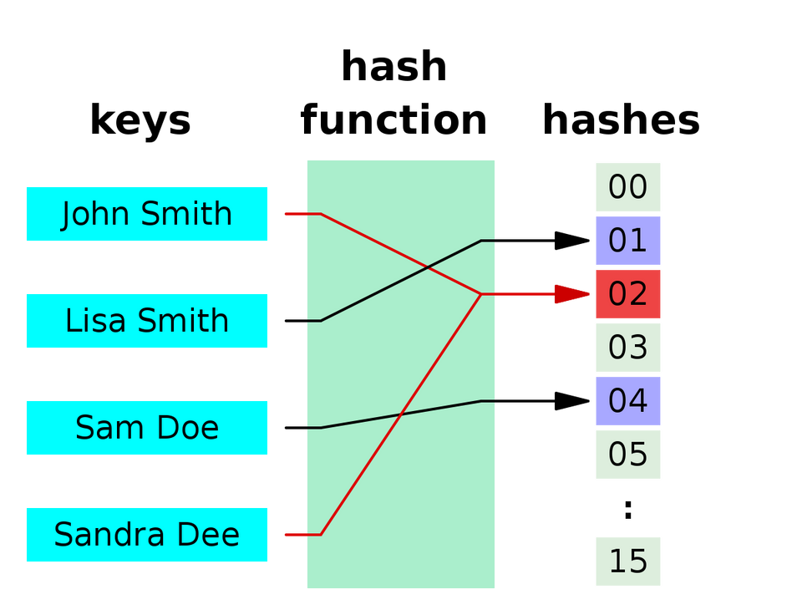
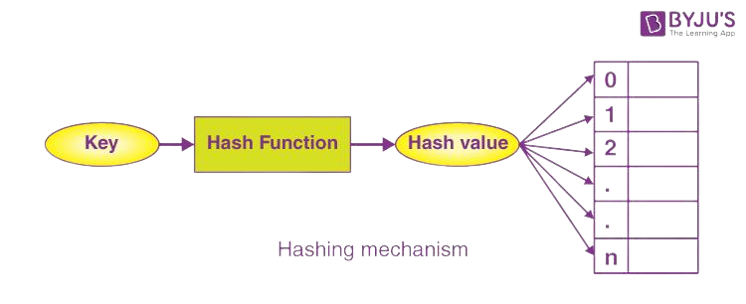
HASHING ALGORITHMS
DSA
Group 7
Hashing is a technique in which a given key field value is converted into address of a storage location of the record by applying some operation on it. This technique is very useful for creating and using Random File Organisation.

Slide 8


INTRODUCTION
DSA
Group 7
File organization is a logical relationship among various records. This method defines how file records are mapped onto disk blocks.
Sequential : File Organization: In this method, data is stored sequentially, with records stored one after the other in a continuous manner.
Hashed : File Organization: This method uses a hash function to determine the storage location of a record based on its key.
Indexed : Indexed File Organization is a type of file organization method used to store and retrieve data in a database or file system.

Slide 9

Topics for Discussion
DSA
Group 7
Hashing algorithm
Collision and Synonym

Slide 10
HASHING TECHNIQUES
TRUNCATION METHOD
POLYNOMIAL DIVISON METHOD
MIDSQUARE METHOD
RADIX CONVERSION METHOD
DIVISION/REMAINDER METHOD
FOLDING METHOD
METHOD OF DIVISION
SHIFTING METHOD
TECHNIQUE 1
TECHNIQUE 5
TECHNIQUE 2
TECHNIQUE 6
TECHNIQUE 3
TECHNIQUE 7
TECHNIQUE 4
TECHNIQUE 8

Slide 11

COLLISION AND SYNONYMS
Main problem with hashing technique is an address generated from two key may be same if more than one record assigned one address is known as collision and address is known as synonym
GROUP 7

Slide 12
TYPES OF COLLISION
AND SYNONYMS
STEPS
AVG. HEART RATE
OPEN
ADDRESS
20077
SEPRATE
CHAINING
67
LAST 48h
LAST 48h
GROUP 7

Slide 13

OPEN ADDRESSING
Open addressing is a technique for dealing with collisions The main idea of open addressing is to keep all the data in the same table to achieve it, we search for alternative slots in the hash table until it is found.
Group 7

Slide 14
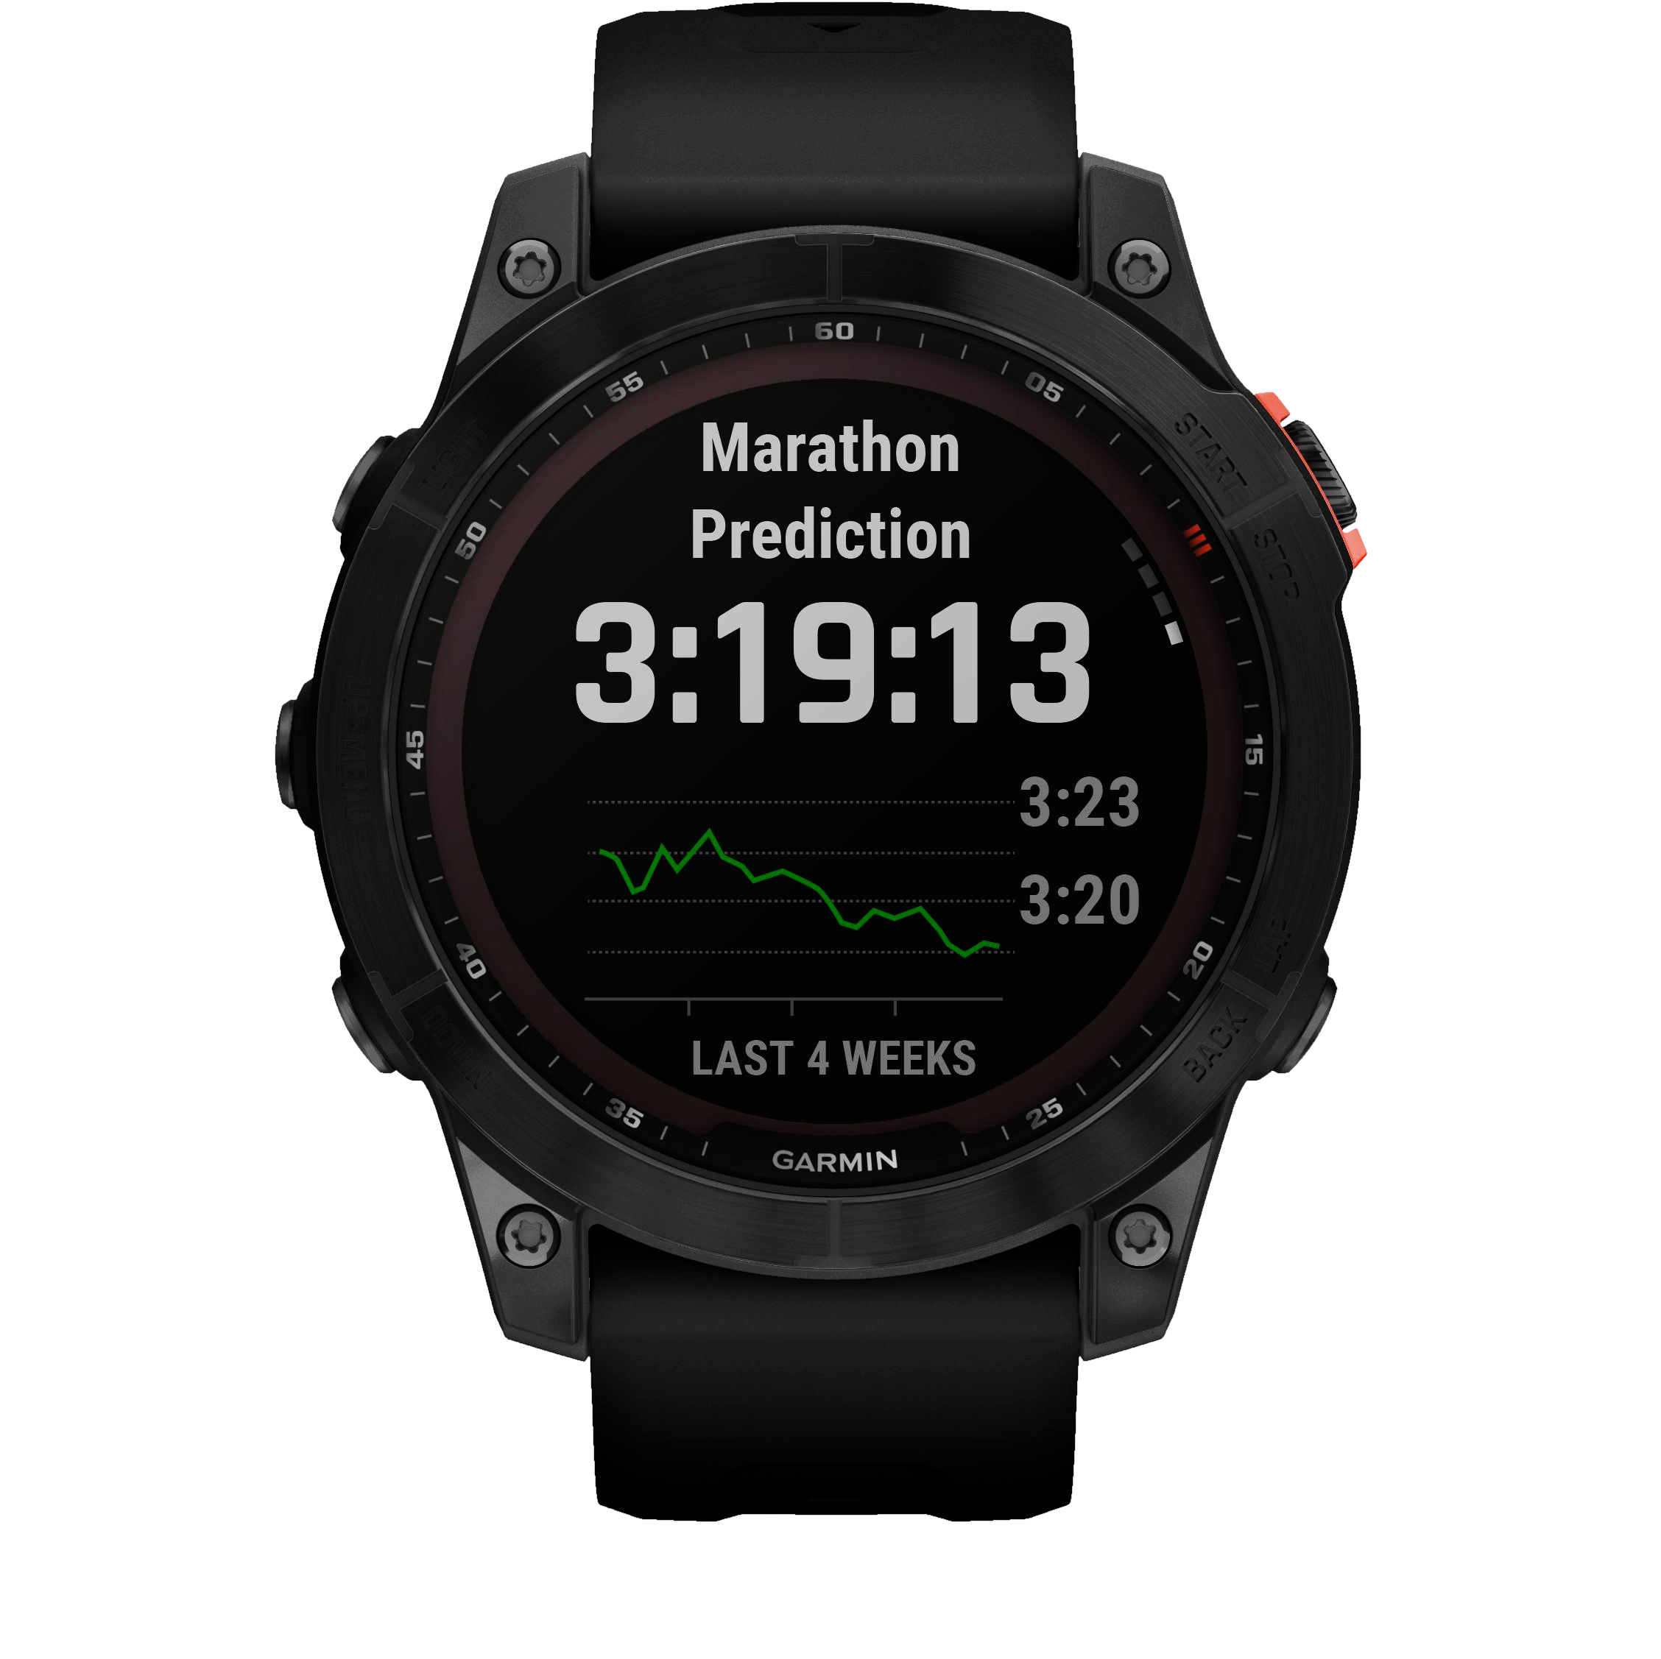
DRAWBACKS OF
OPEN ADDRESSING
CALORIES
5356
GROUP 7
Deletion operation difficult to perform.
Clustering effect.
Time consuming process to find next
available space.
LAST 48h
SYSTEM..

Slide 15

SEPRATE
CHAINING
*Separate Chaining is one of the techniques that is used to resolve the collision. It is implemented using linked lists. This method combines a linked list with a hash table in order to resolve the collision. In this method, we put all the elements that hash to the same slot in the linked list.
DEFINATION
GROUP 7

Slide 16

DIAGRAM OF
SEPARATE CHAINING
*When multiple elements are hashed into the same slot index, then these elements are inserted into a singly-linked list which is known as a chain.
GROUP 7

Slide 17
ADVANTAGES
Channing is very simple and easy to implement.
In chaining, each node has its own pointer, so searching is very fast.
In chaining, we can access only the slot where our value is stored, so the memory utilization is very good.
GROUP 7

Slide 18






EXAMPLE
GROUP 7

Slide 19
DISADVANTAGES
Pointers are used in chaining, so there is memory overhead.
Chaining can have a lower cache hit rate, because pointers make the pattern of memory access unpredictable.
There can be many linked lists in chaining, which increases the complexity of traversing.
GROUP 7

Slide 20

DISADVANTAGES
GROUP 7

Slide 21

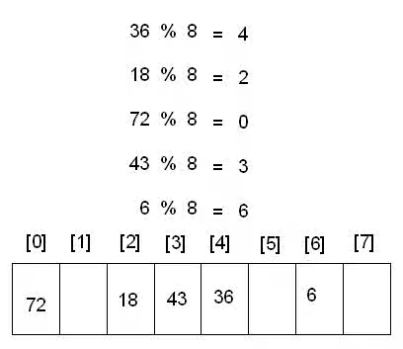
DSA
Group 7
TECH 1:
METHOD OF DIVISION
In this method, the key field value is divided by some suitable number (prime number) So that quotient can be used as a address of the record
H (K) = K MOD M

Slide 22
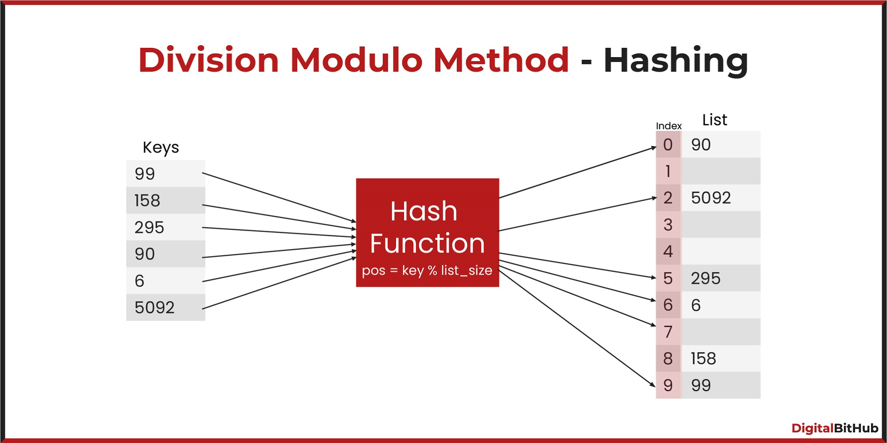
DSA
Group 7
TECH 2:
Division and remainder method
Division and remainder method is a hash function used in file organization data structures, such as hash tables or hash-based file organizations.

Slide 23
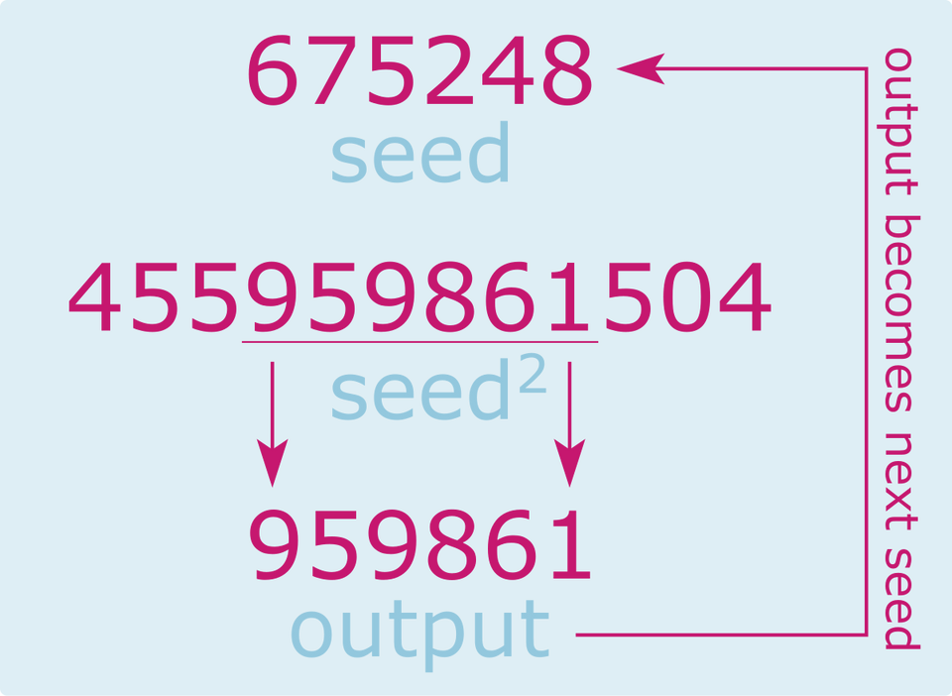
DSA
Group 7
TECH 3:
MIDSQUARE METHOD
Mid-Square hashing is a hashing technique in which the key is
multiplied by itself and the address is obtained by selecting an appropriate number of digits from the middle of the square.
The number of digits selected depends on the size of the table.
For example,
if key =10 is to be transformed
(10)72=100
If the number of locations is 10 then key 10 will be stored in zeroth
position

Slide 24
DSA
Group 7
TECH 4:
TRUNCATION METHOD
The truncation method is a hash function used in computer programming and data structures, specifically in hash-based file organization or hash tables. It involves truncating or extracting a portion from the key and using that portion as the hash value or index.
Suppose a nine digit key field is to converted into four digit address the right most four digit of key can be used as a address

Slide 25


Slide 26


TECH . 5
GROUP
7
SHIFTING
METHOD
1
5
3
2
4
5
3
6
2021 SALES
€131 800
In this method, the outer digits of the key at both ends are shifted inward to overlap by an amount equal to the desired address length. And the digits are added to get the address for the hash table.
1
5
3
2
17,7%
+
4
5
3
6
VS 2020
6
0
6
8

Slide 27


2022 SALES
€232 100
76,1%
Provide some key insights here on how your company sales did in 2022. Keep it short and sweet.
VS 2021
TECH. 6
GROUP
7
FOLDING
METHOD
1
5
4
0
2
3
1
3
4
0
2
3
In folding method the digits in the key are folded inward file a folding paper, then the digits are added to obtain the address in hash table
4
3
1
+
4
5
1
9
0
5

Slide 28
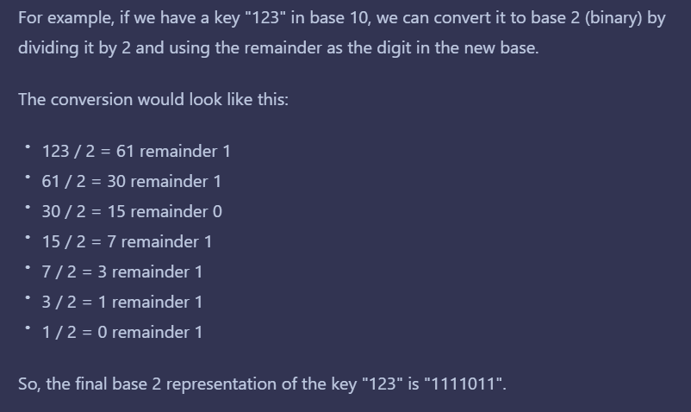
2022 SALES
€232 100
76,1%
Provide some key insights here on how your company sales did in 2022. Keep it short and sweet.
VS 2021
TECH. 7
GROUP
7
RADIX
CONVERSION
METHOD
In this method the radix or the base is converted into another radix or base, usually 2(binary) or 10.

Slide 29

2022 SALES
€232 100
76,1%
Provide some key insights here on how your company sales did in 2022. Keep it short and sweet.
VS 2021
TECH. 8
GROUP
7
POLINOMIAL
DIVISION METHOD
Example:-
if the key is 123456, the polynomial
representation would be
This method involves treating the key as a polynomial and dividing it by another polynomial to obtain the hash value.

